Slide 1
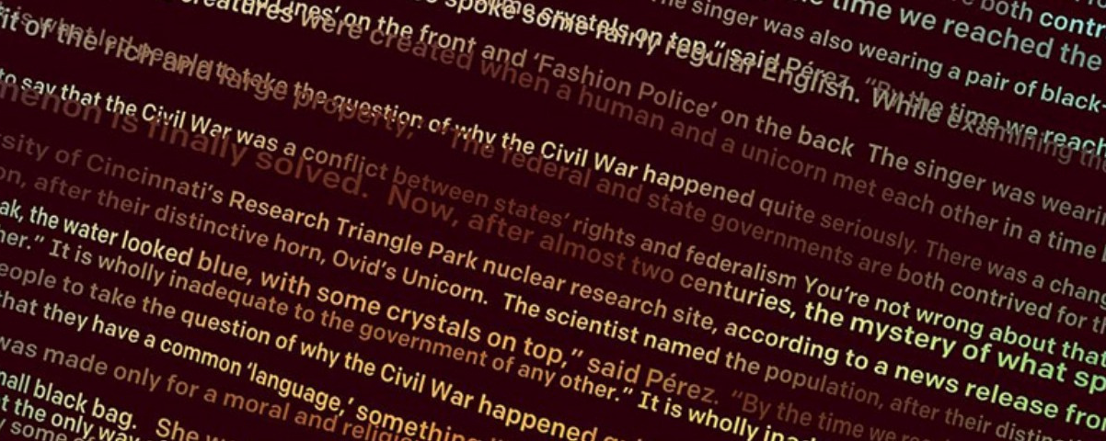
Text Generation Machine Learning Project (GAN-Dalf)
Designing Deep Learning models for memorable quote generation using Natural Language Processing, LSTM and GANs.

Slide 2
Index
1 - Introduction
2 - Natural Language Processing
3 - LSTM Modeling
4 - GAN Modeling
5 - Predictions
6 - Conclusions
"I Think This Is The Beginning Of A Beautiful Friendship."

Slide 3

1 - Introduction
Defining the project steps
Natural Language Processing
LSTM Neural Networks
Generative Adversarial Networks
Explaining the preprocessing tecniques involved around text generation models.
Using Long-Short-Term Memory NNs for predicting the next character/word in a sequence.
Training a generator and a discriminator in order to obtain plausible text outputs.

Slide 4
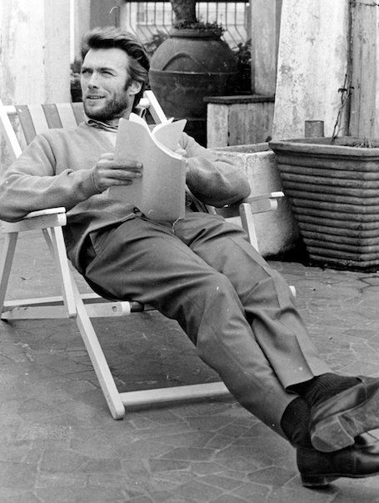
2 - Natural Language Processing
"I was a book, I was the world."

Slide 5
2 - Natural Language Processing
CHARACTER INPUT STATS
52
UNIQUE CHARACTERS
Tecnique consisting in tokenizing sequences and encoding them into One-Hot Arrays.
40
SEQUENCE LENGTH
- Character-Level: Low computational demand and efficient in short-length corpus text.
- Word-level: High computational demand and more efficient with complex models and extensive corpus texts.
WORD INPUT STATS
3501
UNIQUE WORDS
5
SEQUENCE LENGTH

Slide 6
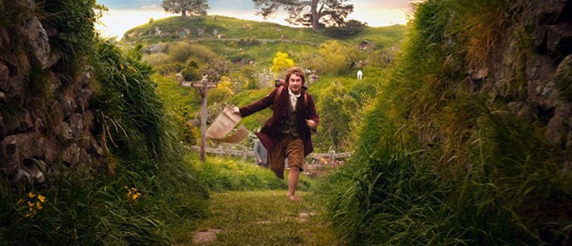
3 - LSTM Modeling
"I'm going on an adventure."

Slide 7
3 - LSTM Modeling
Predicting the next character/word in a given sequence.
01
02
03
04
Dense Input
LSTM
Dense Output
Compilation
Standard Layer with an Input array of shape (40,52).
Long-Shot-Term Memory Layer.
Standar Layer with output shape of 52 values with a softmax activation.
Categorical crossentropy with a RMSProp Optimizer.

Slide 8
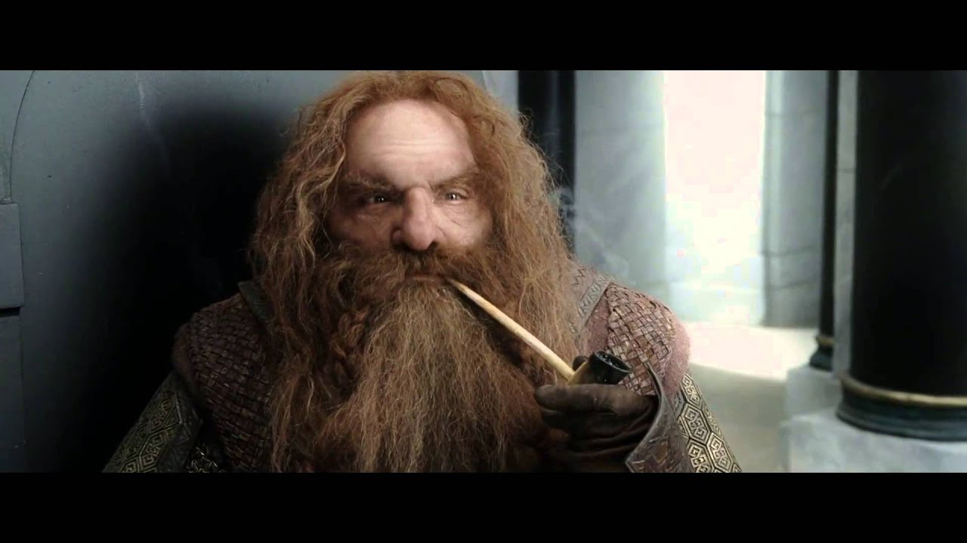
4 - GAN Modeling
"Certainty of death. Small chance of success. What are we waiting for?"

Slide 9
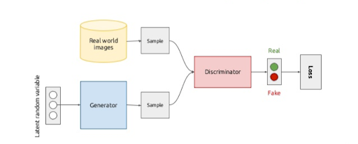
4 - GAN Modeling
Generative Adversarial Networks

Slide 10
Discriminator
Generator
Convolution
1D convolution layer
Dense
Standard Layer
LeakyRelu
Leaky version of a Rectified Linear Unit. Allows a small gradient
LeakyRelu
Leaky version of a Rectified Linear Unit. Allows a small gradient
Dropout
Regularization layer
BatchNormalization
Normalizes its inputs

Slide 11
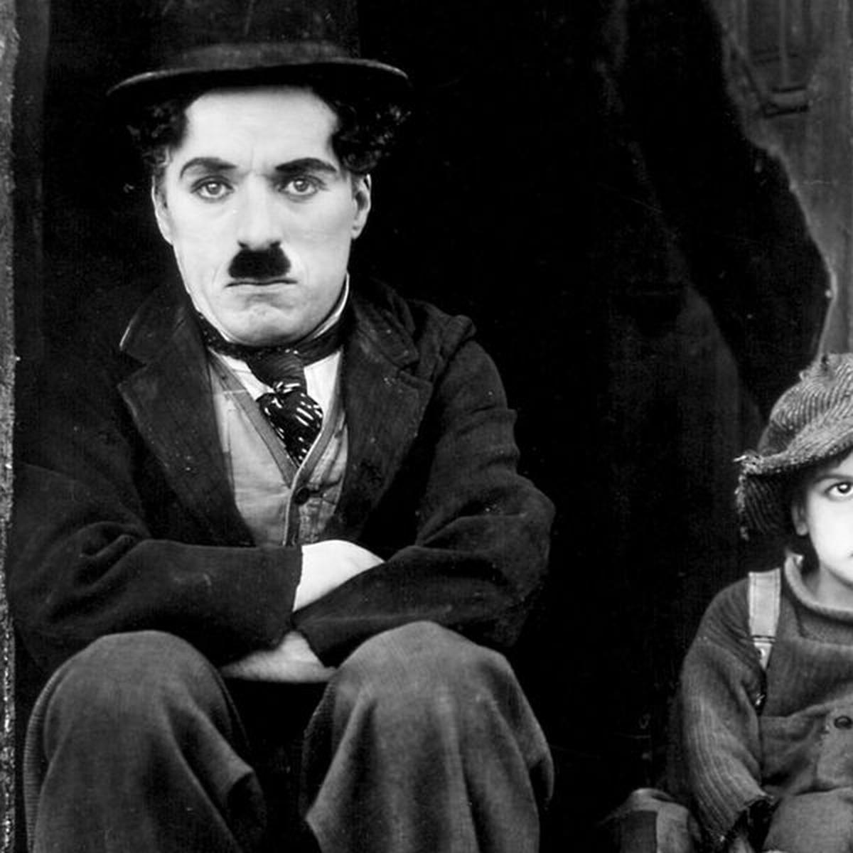
5 - Predictions
"The first secret of the more miles with the man who was the man."

Slide 12




5 - Predictions
Input Text: "I love the smell of napalm in the morning."
Character LSTM
Word LSTM
"The stars the truth. I don't know that."
"Teach spirit they for start young heard do nor up."
Character GAN
Word GAN
"reehulefulnyuleeef ef e eahefule hema."
"Ohh appreciate says paying midnight."

Slide 13
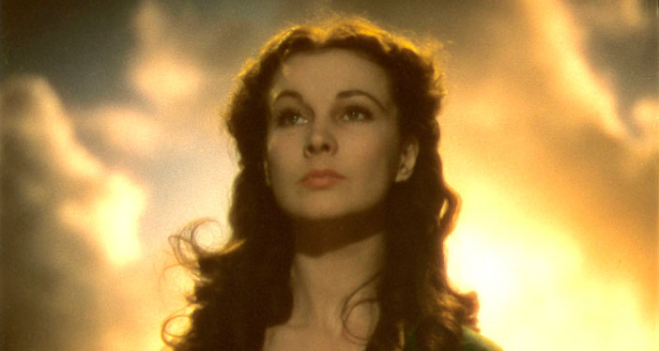
6 - Conclusions
"After all, tomorrow is another day."

Slide 14
6 - Conclusions
Reflecting on results
01
02
03
Underwhelming GAN Outputs
Character LSTM - The Best Model
Future Considerations
Although the GAN structure was successfully implemented, Gen-Disc stabilization was reached too soon, resulting in poor-quality outputs.
The simplest model gave the overall best results, bearing in mind no model managed to reach a reasonable output.
Designing a better optimized code, using high-demand processors and further model investigation is required in order to achieve better results.

Slide 15
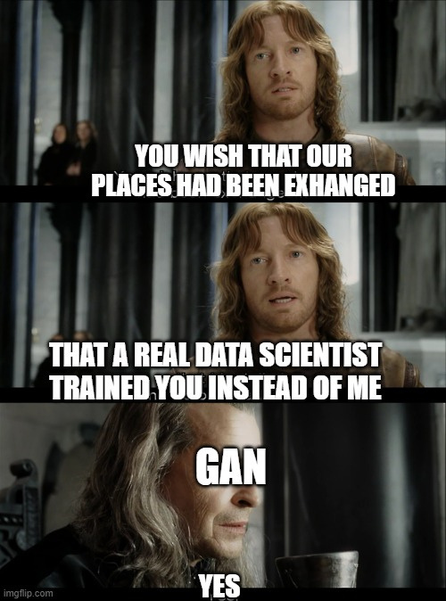

Slide 16


Thank you for your attention
email: jgn.sando@gmail.com
linkedIn: www.linkedin.com/in/jorge-garcía-navarro-532674108/

